Slide 1
AWS Introduction
Presented by Vishwanath M S
Cloud Architect

Slide 2
Agenda
The 5 Pillars of the AWS Well-Architected Framework
Regions and Availability Zone
Your Questions

Slide 3
The 5 Pillars of the AWS Well-Architected Framework
Cost Optimization
Reliability
Operational Excellence
Performance Efficiency
Security
Note: -- Abbreviation -- (CROPS)

Slide 4
Cost Optimization
Design Principles
There are five design principles for cost optimization in the cloud:
Adopt a consumption model
Measure overall efficiency
Stop spending money on data center operations
Analyze and attribute expenditure
Use managed services to reduce cost of ownership

Slide 5
Reliability
Design Principles
There are five design principles for reliability in the cloud:
Test recovery procedures
Automatically recover from failure
Scale horizontally to increase aggregate system availability
Stop guessing capacity
Manage change in automation

Slide 6
Operational Excellence
Design Principles
There are six design principles for operational excellence in the cloud:
Perform operations as code
Annotate documentation
Make frequent, small, reversible changes
Refine operations procedures frequently
Anticipate failure
Learn from all operational failures

Slide 7
Performance Efficiency
Design Principles
There are five design principles for performance efficiency in the cloud:
Democratize advanced technologies
Go global in minutes
Use serverless architectures
Experiment more often
Mechanical sympathy

Slide 8
Security
Design Principles
There are six design principles for security in the cloud:
Implement a strong identity foundation
Enable traceability
Apply security at all layers
Automate security best practices
Protect data in transit and at rest
Prepare for security events

Slide 9
Concepts of Region and AZ and Edge Location
AWS has 22 regions , out of which 3 are China Regions, which are not accessible.
Each region has min of 2 (Availability Zone) and max of 6 AZ.
Total of 69 Availability Zone and each Availability Zone could have multiple Datacenter
Each Availability Zone are interconnected with HIGH BANDWIDTH (BACKHOLE LINK, more than 1000Gbps)
Each Region is also connected with other region. (The speed might be less when compared to above).

Slide 10
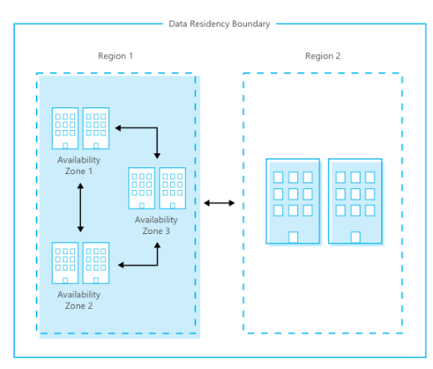
Regions and Availability Zone
An AZ is a datacenter owned and operated by AWS.
AZ’s are represented by a Region Code, followed by a letter identifier, us-east-1a.
<10ms latency between AZ’s

Slide 11
AWS Edge Network Locations
An Edge Location is an datacenter owned by a trusted partner of AWS which has a direct connection to the AWS network.
Services Offered at AWS Edge
Amazon CloudFront
Amazon Route 53
AWS firewall Manager
AWS Shield
AWS WAF

Slide 12
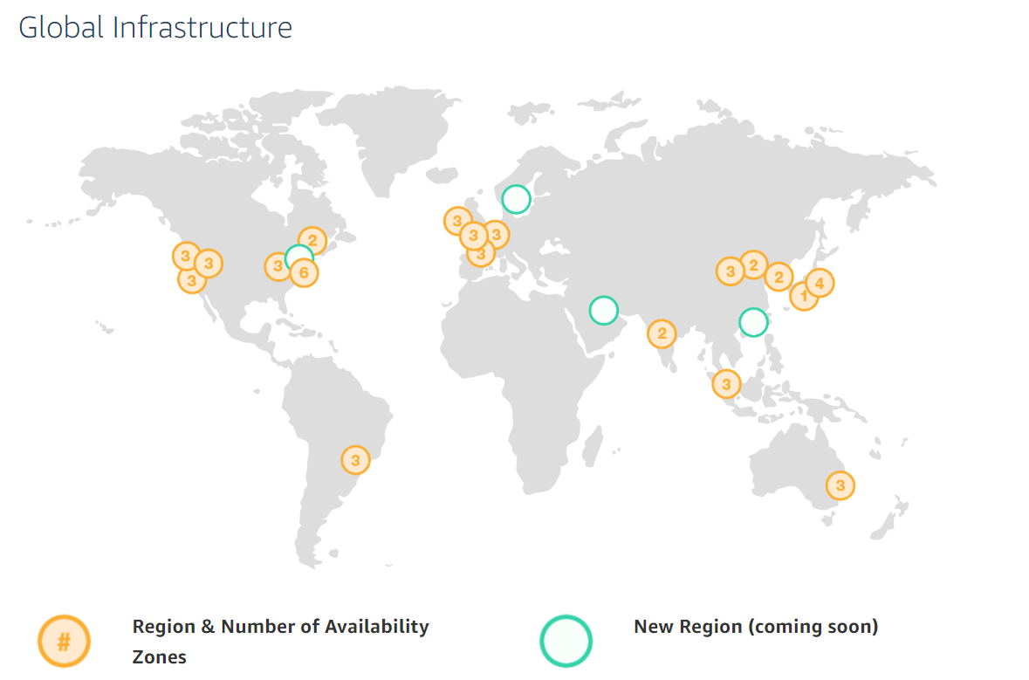

Slide 13
GovCloud (US)
AWS GovCloud regions allow customers to host sensitive Controlled Unclassified Information and other types of regulated workloads.
GovCloud Regions are only operated by employees who are U.S Citizens, on U.S Soil.
Customers can architect secure cloud solutions that comply with:
FedRAMP High baseline
DOJ’s Criminal Justice Information systems (CJIS) Security Policy
U.S International Traffic in Arms Regulations (ITAR)

Slide 14
Ref Link
https://docs.aws.amazon.com/AWSEC2/latest/UserGuide/using-regions-availability-zones.html
https://aws.amazon.com/about-aws/global-infrastructure/

